Slide 1
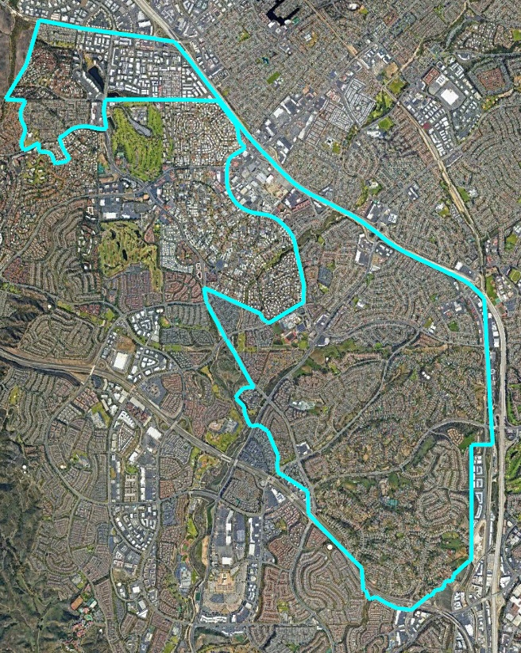
City of Laguna Hills
Introduction to Districting
Dr. Justin Levitt, Vice-President
National Demographics Corporation

Slide 2
Election Systems
“At Large”
“From District” or “Residence” Districts
“By District”
The California Voting Rights Act was written to specifically encourage by-district elections.

Slide 3
California Voting Rights Act (CVRA)
Under the Federal Voting Rights Act (passed in 1965), a jurisdiction must fail 4 factual tests before it is in violation of the law.
The California VRA makes it significantly easier for plaintiffs to force jurisdictions into “by-district” election systems by eliminating two of the US Supreme Court Gingles tests:
  Can the protected class constitute the majority of a district?
  Does the protected class vote as a bloc?
  Do the voters who are not in the protected class vote in a bloc to defeat the preferred candidates of the protected class?
  Do the “totality of circumstances” indicate race is a factor in elections?
Liability is now established by just the presence of racially polarized voting and dilution of the protected class’s ability to elect or influence the outcome of elections.

Slide 4
CVRA Impact
Switched (or in the process of switching) as a result of CVRA:
  At least 328 school districts
  46 Community College Districts
  200+ cities
  1 County Board of Supervisors
  75 water and other special districts.
Palmdale, Santa Clara and Santa Monica fought “on the merits.” All lost.
  Santa Monica: CA Supreme Court sent case back down. Now back in Superior Court.
  Palmdale spent about $1.8 million, Santa Clara $1.37 million, and Santa Monica over $7 million, just on their defense.
  Santa Monica plaintiffs requested $22 million
  So far, no jurisdiction has won a case.
Key settlements:
  Palmdale: $4.7 million
  Santa Clara: $3.8 million
  Modesto: $3 million
  Highland: $1.3 million
  Anaheim: $1.1 million
  Whittier: $1 million
  Santa Barbara: $600,000
  Tulare Hospital: $500,000
  Camarillo: $233,000
  Compton Unified: $200,000
  Madera Unified: about $170,000
  Hanford Joint Union Schools: $118,000
  Merced City: $42,000
An estimated $20 million in total settlements and court awards so far.

Slide 5
Districting Process 1
Step | Description
Two Initial Hearings October 7 & 14, 2025 | Held prior to release of draft maps. Education and to solicit input on the composition of districts.
Community Workshop October 15, 2025 | Education and to solicit input on the composition of districts.
First Deadline for Community Maps October 17, 2025 | Maps must be in by 5 pm Last day to receive maps for processing for the October 28th Public Hearing
Release draft maps October 21, 2025 | Maps must be posted at least 7 days prior to 3rd hearing.
Third hearing on the draft maps October 28, 2025 | First of two meetings to discuss and revise the draft maps and to discuss the election sequence.
Community Workshop Early November 2025 | Date To Be Announced Community opportunity to discuss draft maps

Slide 6
Districting Process 2
Step | Description
Second Deadline for Community Maps November 7, 2025 | Maps must be in by 5 pm Last day to receive maps for processing for the November 18th Public Hearing
Release revised maps November 11, 2025 | Maps must be posted at least 7 days prior to 4th hearing.
Fourth hearing on the draft maps November 18, 2025 | Second of two meetings to discuss and revise the draft maps and to discuss the election sequence.
Map Adoption December 9, 2025 | Final map and sequence must be posted at least 7 days prior to adoption.
First election November 3, 2026 | First elections in new districts in 2026 & 2028

Slide 7
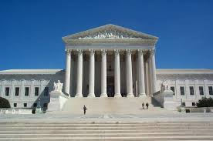
Districting Rules and Goals
1. Federal Laws
2. California Criteria
2. California Prohibition
Equal Population
Federal Voting Rights Act
No Racial Gerrymandering
In prioritized order:
Geographically contiguous
Avoid division of neighborhoods and “communities of interest”
(Socio-economic geographic areas that should be kept together)
Easily identifiable boundaries
Compact
(Do not bypass one group of people to get to a more distant group of people)
“Shall not adopt election district boundaries for the purpose of favoring or discriminating against an incumbent, political candidate, or political party.”
3. Other Traditional Redistricting Principles
Future population growth

Slide 8
Key Demographics
Each of the five Districts will contain about 6,280 people.
“Citizen Voting Age Population” data from the Census Bureau’s American Community Survey is considered the best available data on “eligible voters.”

Slide 9
Demographic Summary
Each of the five Districts will contain about 6,280 people.
Additional demographic information from the American Community Survey and Statewide Database can be used to understand communities

Slide 10
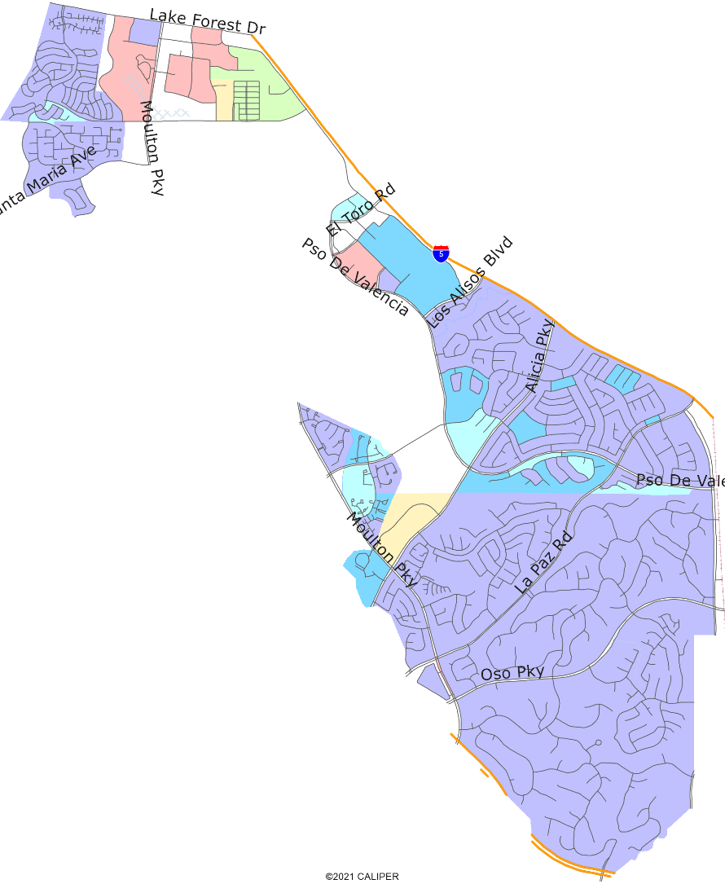
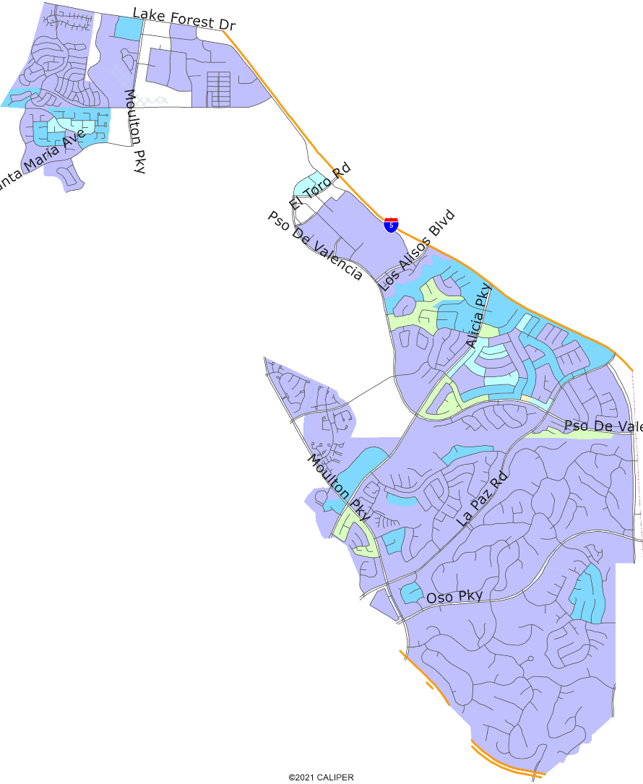
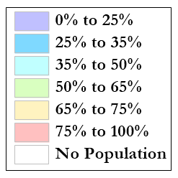
Latino CVAP Asian CVAP
Latinos are concentrated in the Laguna Hills Mobile Estates and Aliso Meadows.
Asians are slightly concentrated along Alicia Parkway.

Slide 11

Defining Neighborhoods
1st Question: How do you describe or name the area where you live?
2nd Question: What are its geographic boundaries?
What other neighborhoods are there?
Examples of physical features defining a neighborhood boundary:
Natural neighborhood dividing lines, such as highway or major roads, rivers, canals and/or hills
Areas around parks or schools
Other neighborhood landmarks

Slide 12
Defining Communities of Interest
California Elections Code Section 21130(c)(2):
  A “community of interest” is a population that shares common social or economic interests that should be included within a single district for purposes of its effective and fair representation.
  The shared interests may include (but are not limited to):
  Shared public policy concerns such as education, public safety, public health, environment, housing, transportation, and access to social services. cultural districts;
  Shared socioeconomic characteristics;
  Similar voter registration rates and participation rates; and /or
  Shared histories.
Definitions of Communities of Interest may not include relationships with political parties, incumbents, or political candidates.

Slide 13
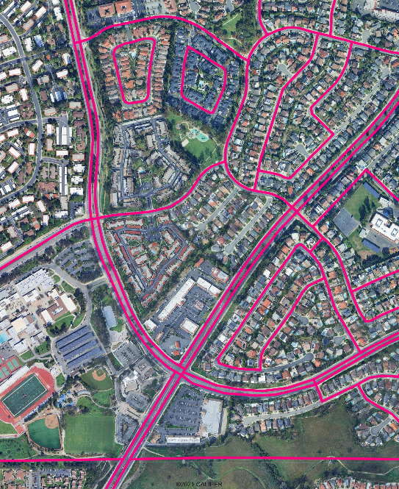
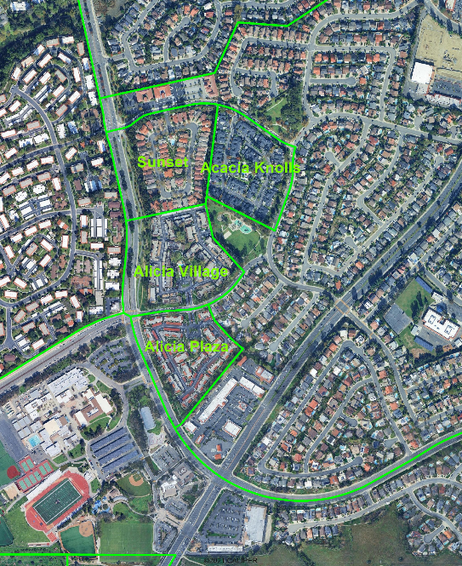
Census Block Problems
Census Block lines (shown in pink) do not turn out well where there are hillsides, cul-de-sacs or multiple developments not clearly bounded by streets.
Census Block lines in Laguna Hills cut through neighborhoods and combine neighborhood pieces almost randomly.
NDC has carefully divided the Census Blocks and assigned their population shares to the underlying neighborhoods.
The base layer of geography for maps will be based on local neighborhood boundaries within Census Blocks.

Slide 14
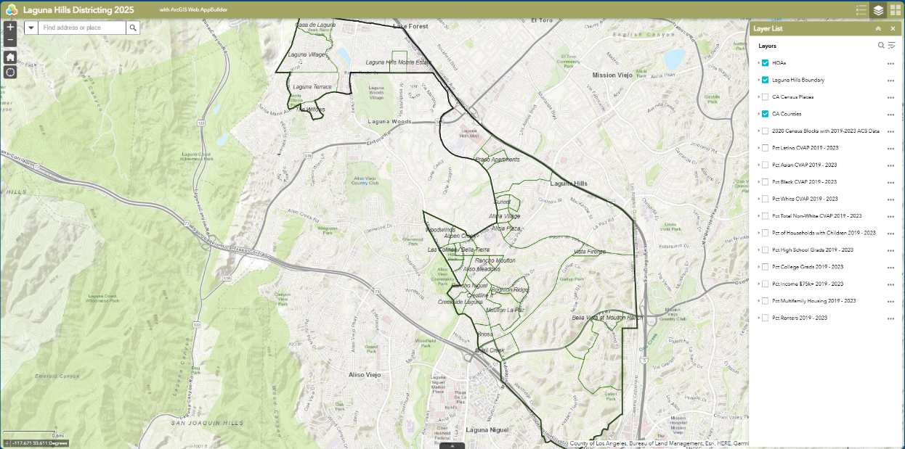
Public Mapping and Map Review Tools
Different tools for different purposes
Different tools for different levels of technical skill and interest
  Simple “review draft maps” tool
  Paper-based “Draw a draft map” tool

Slide 15





Your Turn:
What area do you consider your neighborhood?
What are your “communities of interest”?
For each answer, please provide:
Geographic boundaries
The history or defining shared characteristic of the area
In the absence of public testimony, planning records and other similar documents may provide definition.
Any other questions about the process, criteria, maps, tools or any other part of this process?

Slide 16
Share Your Thoughts
Website
https://maplh.org/
Email
jlee@lagunahillsca.gov
Phone
(949) 707-2630

